Slide 1
BRAINSTALK – A WEB APPLICATION FOR E- LEARNING MANAGEMENT

Slide 2
S.no | Contents
1. | Contents
2. | Problem Statement
3. | Introduction
4. | Abstract
5. | Objective
6. | Functionalities
7. | Software & Hardware requirements
8. | Methodology
9. | Conclusion
Page 1

Slide 3
Problem Statement
With the advent in technology and with the perpetual increase in the strength of the students and the number of departments inthe educational institutions, it is laborious to exchange the study materials between the students and the faculties.
The main objective of the E-Learning is to help the students get over the traditional methods of learning and make them accustomed to the internet where the notes for their respective subjects are easily available. It provides an automation procedure of studying the notes online. The implementation of this project helps both the students and the teachers.
This project not only helps to facilitate easier access to the online academic activities for the students but also helps cutting down on expenditure for the universities as well. Students and Universities alike spend a considerable amount of money on infrastructure and different physical activities which can be lowered with the help of E-Learning platform.
Page 2

Slide 4

Introduction
The ‘BrainStalk’ ‘E-Learning Management Platform’ is developed to overcome the challenges Institutions are face in transforming from the ‘Traditional (Manual) Education System or weak online systems to a complete E-Learning System. Moreover our platform will be designed for the particular needs of the institutions. Different institutions will be aple to modify the platform with just few click on the basis of their needs.
Page 3

Slide 5
Abstract
The purpose of ‘BrainStalk’ E-Learning Management Platform is to help institutions to achieve the goals of E-Learning and eliminate the traditional education system or the hardships they face due to lack of complete online solution for teaching which involves different manual operations and a whole lot of burden due to spreaded system.
‘BrainStalk’, as described above, will lead to interactive, secure, reliable and one of a kind E-Learning Management Platform. ‘BrainStalk’ will help students to concentrate on learning and Teachers to concentrate on teaching instead of worrying about keeping different students records like Attend, Scores, Timetable, Assignments and a lot more.
Page 4

Slide 6
Objective
The aim is to develop a system which will not only help in providing a better way of online education but also provide a Interactive and Attractive platform. Because, many platform’s lacks behind in these two qualities which lead to their termination or desertion. ‘BrainStalk’ will help students to concentrate on learning and Teachers to concentrate on teaching instead of worrying about keeping different essential academic records as they will be automatically generated.
Page 5

Slide 7


Functionalities
Video Lectures
Live Classes
Quizzes
Exams
Practical/Lab Sessions
Blogs
Professor’s Views
Placement Guide’s Etc.
Forum
Course Materials
Notes in Ppt’s or PDF format
Syllabus
Assignments Etc.
Attendance
Timetable
Blogs
Professor’s Views
Placement Guide’s Etc.
Notification Board
Administrative Access to modify platform with just few clicks. and many more.
Page 6

Slide 8
SOFTWARE & HARDWARE REQUIREMENTS
Hardware Requirements:
Personal Computer
Laptop
Languages, Frameworks:
JavaScript
EJS
CSS
React.Js
Bootstrap
Server:
Node.Js
Software’s / IDE’S /Text Editors:
Node.js
MongoDB
MongoDB Compass
Visual Studio Code
Web Browser
Page 7

Slide 9


Methodology
The front-end work is done with the help of our knowledge related to EJS/ React.js, Javascript, CSS, and Bootstrap. The back-end work is done with the help of Node.JS, Express.JS & MongoDB. We used the localhost NODE server for now and later we will deploy the portal on globalhost. The proper database is created to record every information and will make it sure to follow a proper privacy policy as everything is stored in Cloud (MONGODB ATLAS).

Slide 10
Conclusion
This project should prove to be a powerful package in satisfying all the requirements of an institution. The objective behind this project is to develop a system which will not only help in providing a better way of online education but also provide a Interactive and Attractive platform and we believe that on completion of this project, the objective will be fulfilled successfully.

Slide 11
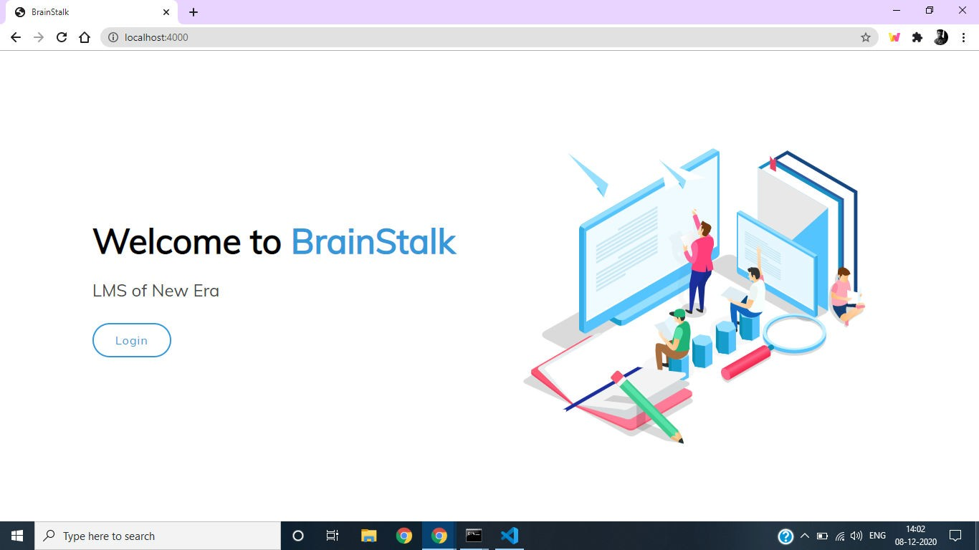
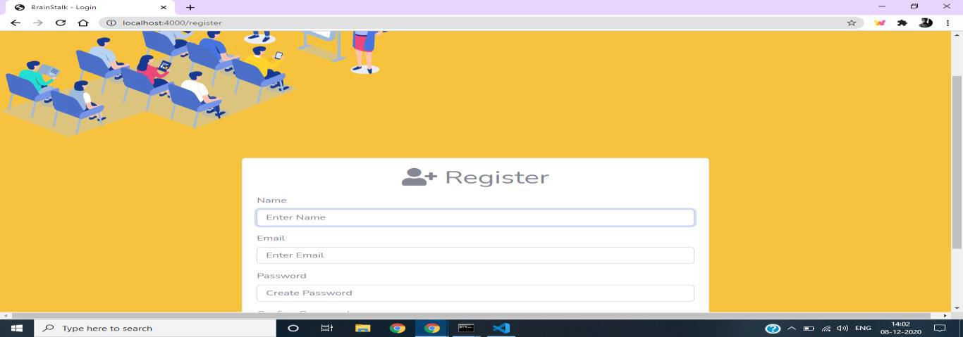
Result Ans Output
Faculty/Teacher’s Portal
1. Home Page
2. Registration Page

Slide 12
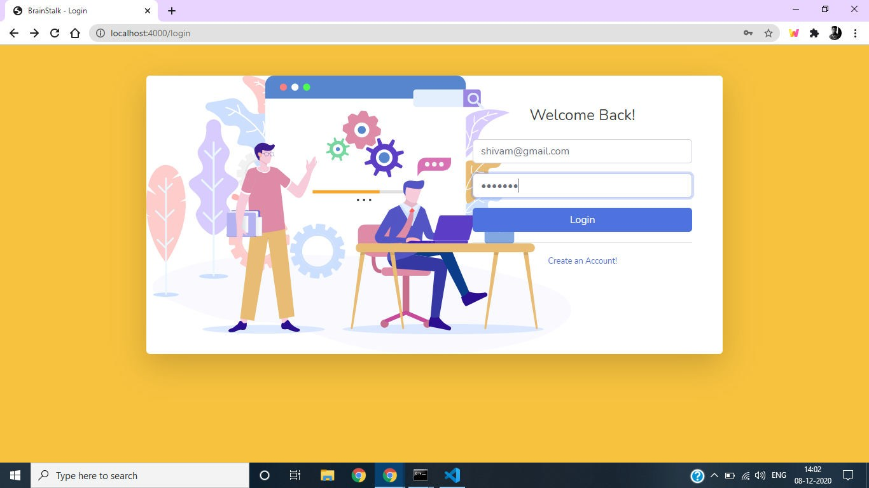
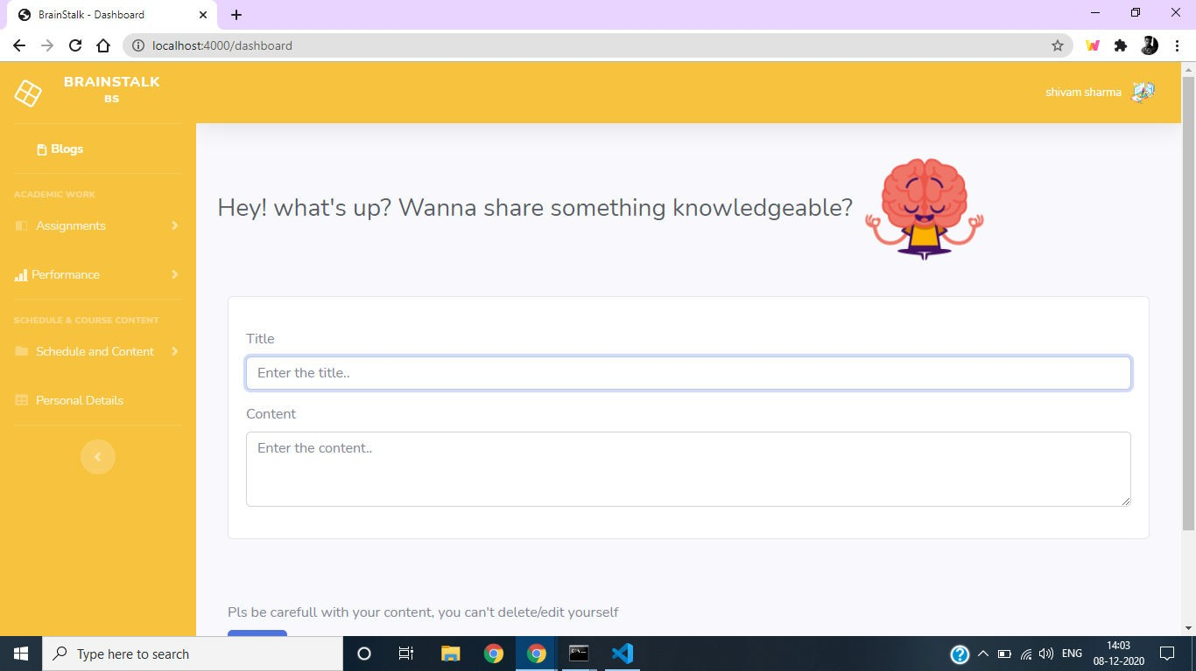
3. Login Page
4. Faculty Dashboard

Slide 13
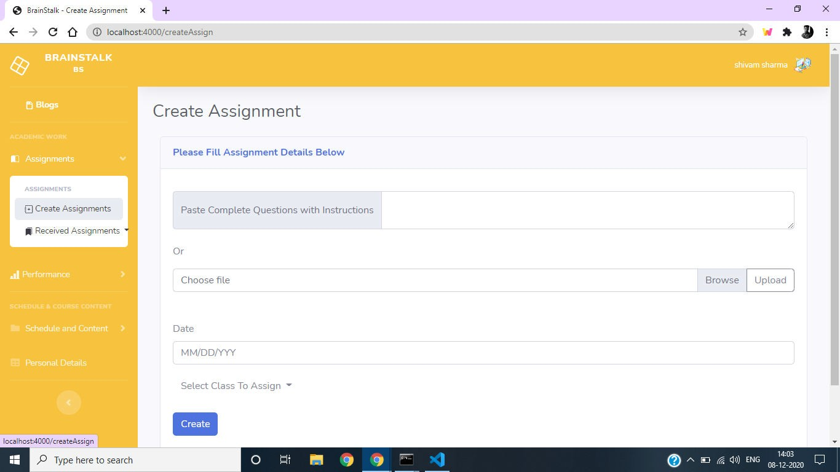
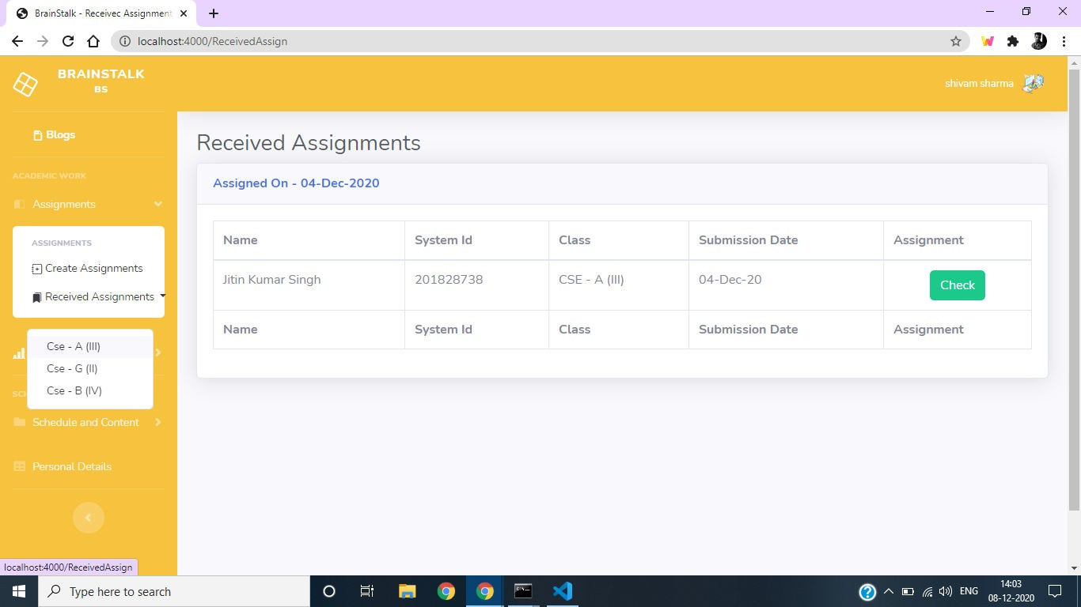
5.
6.

Slide 14
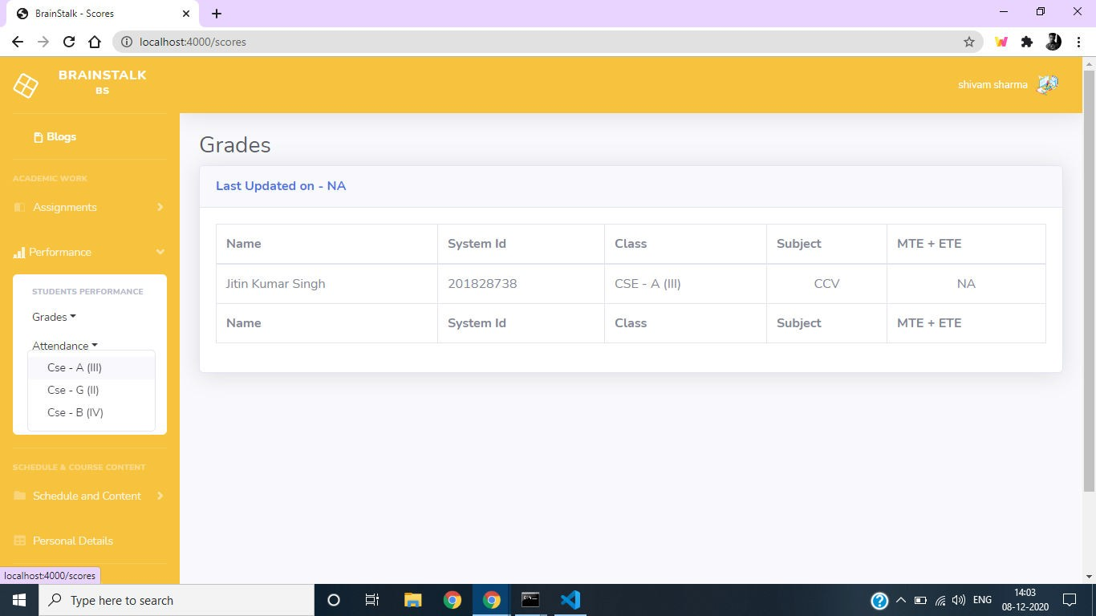
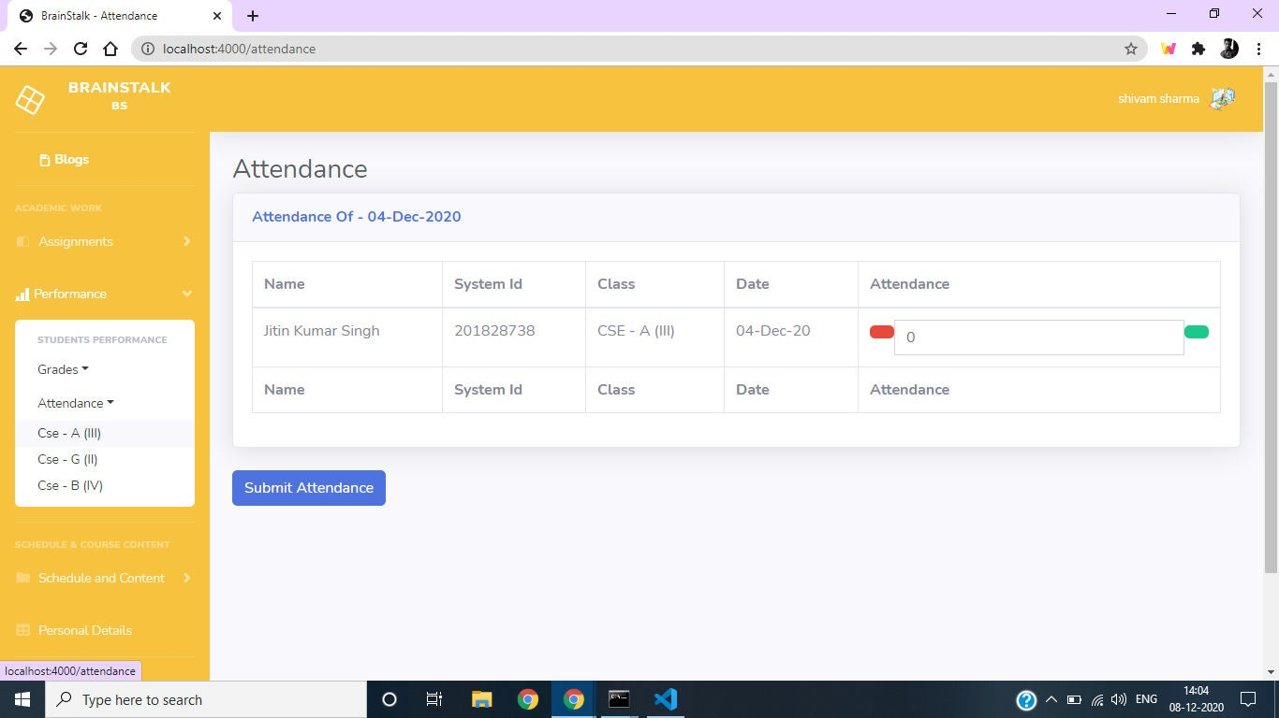
7.
8.

Slide 15
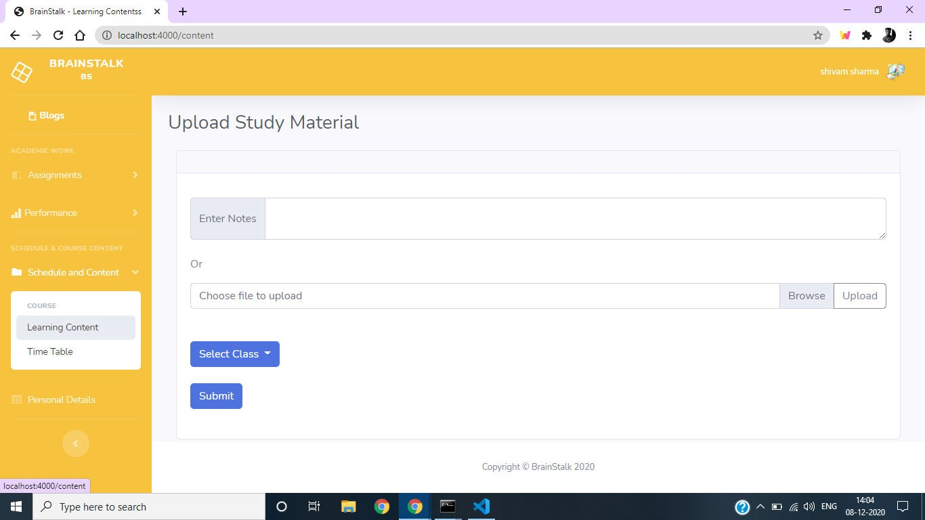
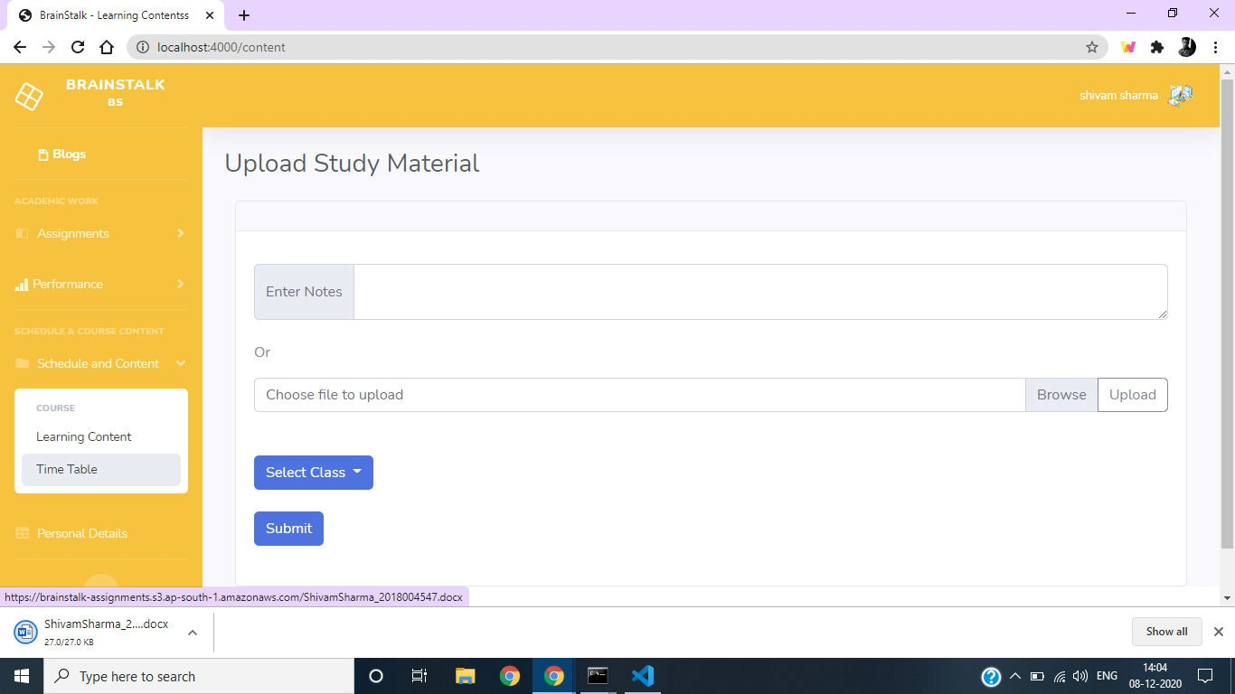
9.
10.

Slide 16
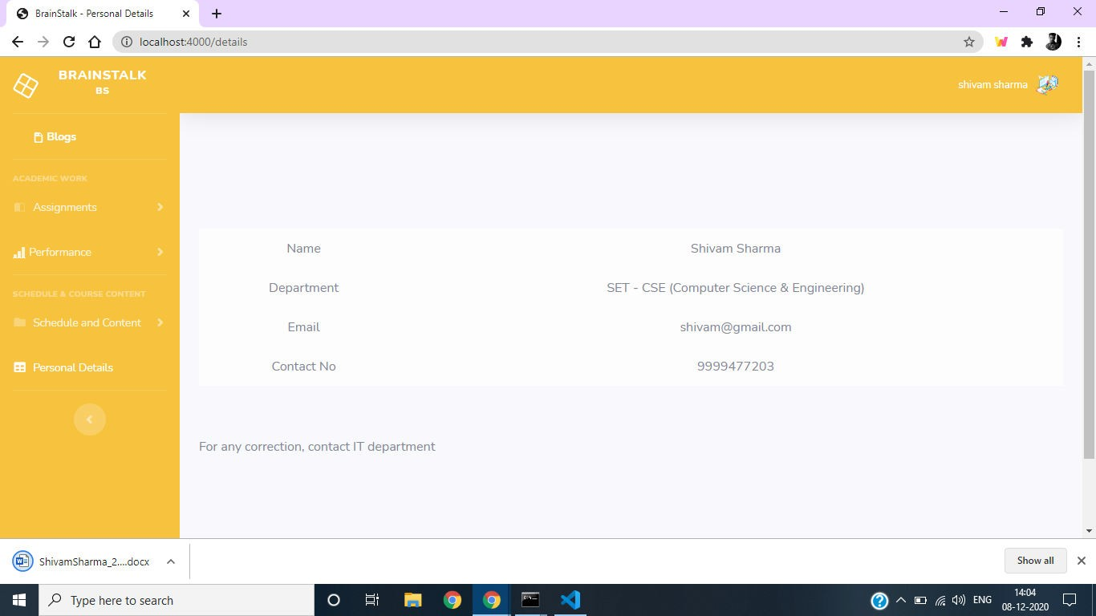
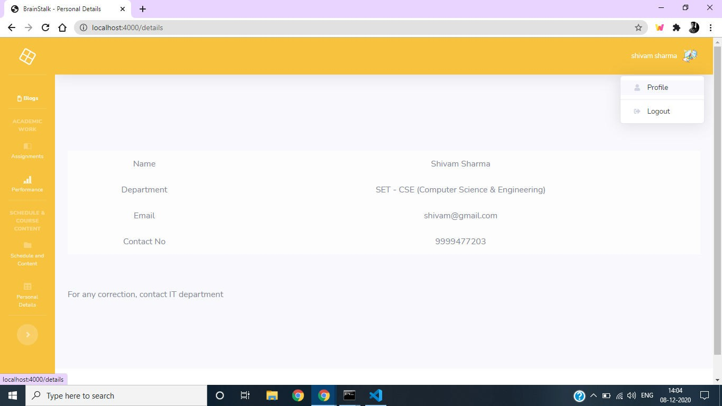
11.
12.

Slide 17
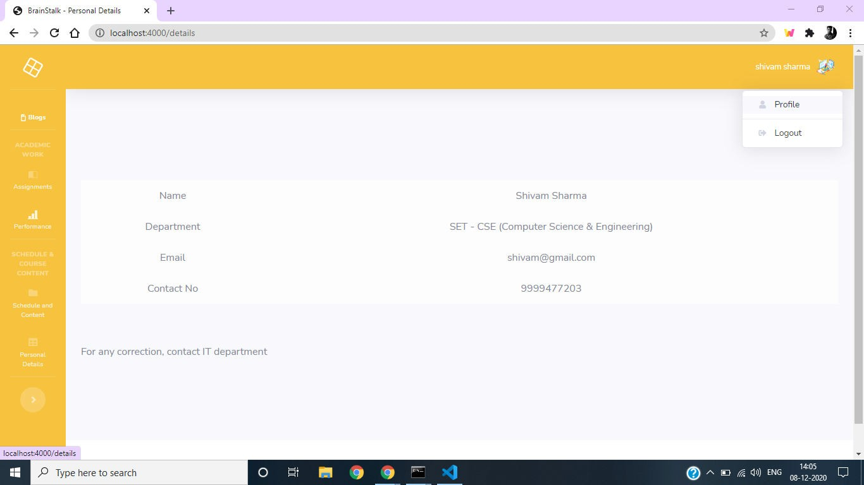
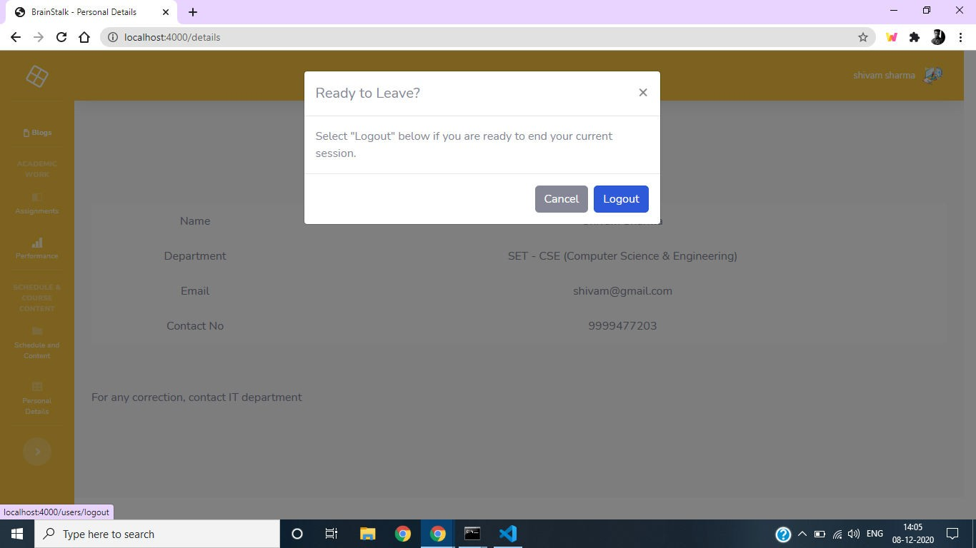
13.
14.

Slide 18
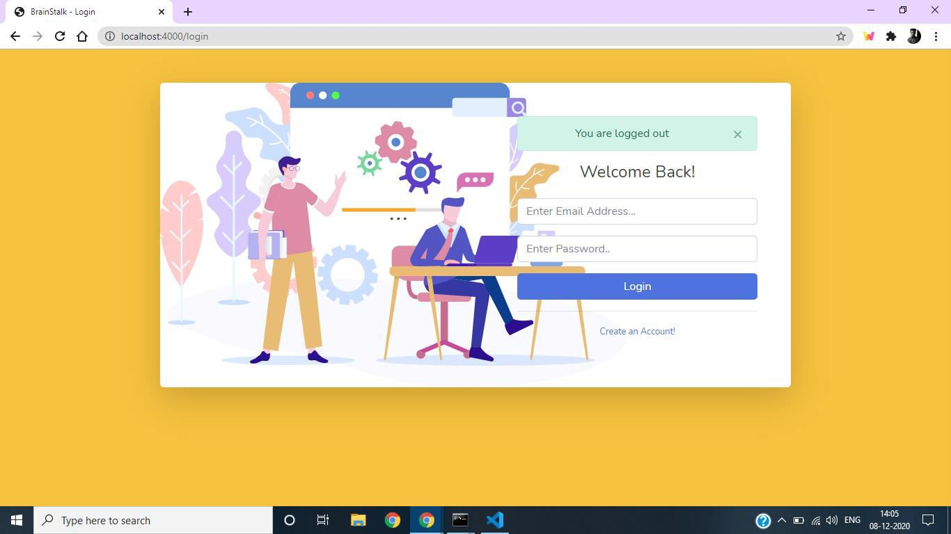
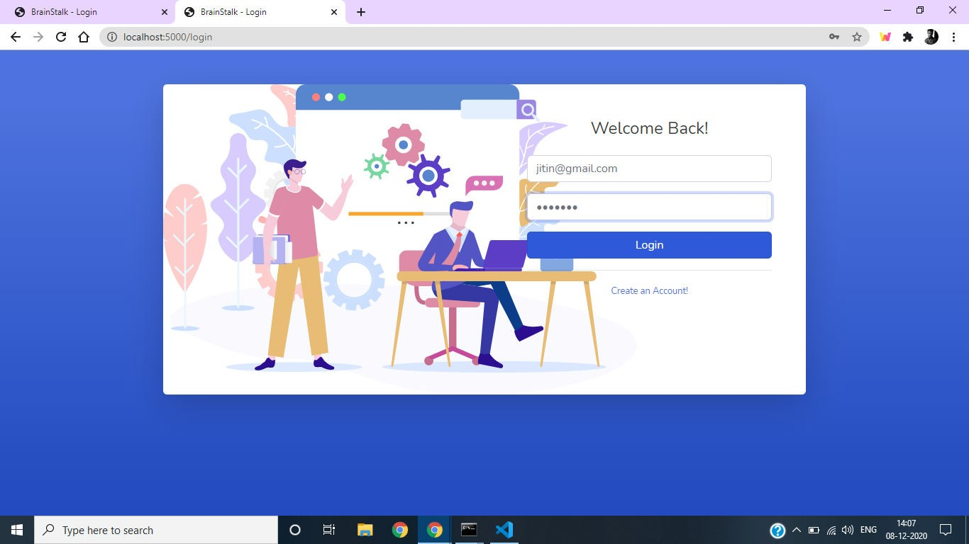
15.
Student’s Portal

Slide 19
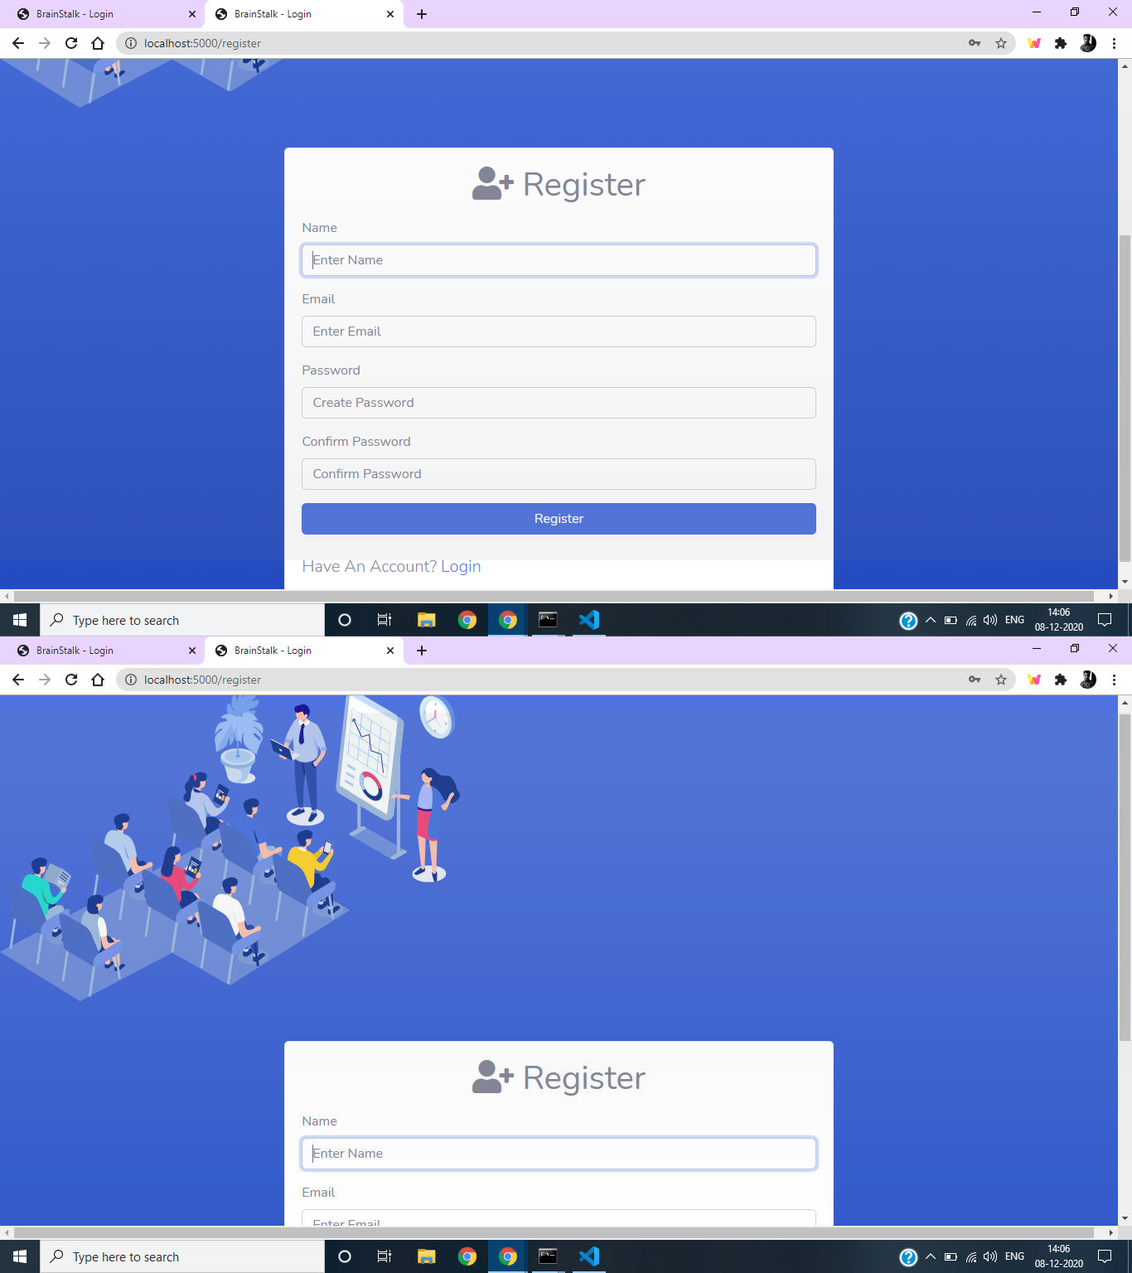

Slide 20
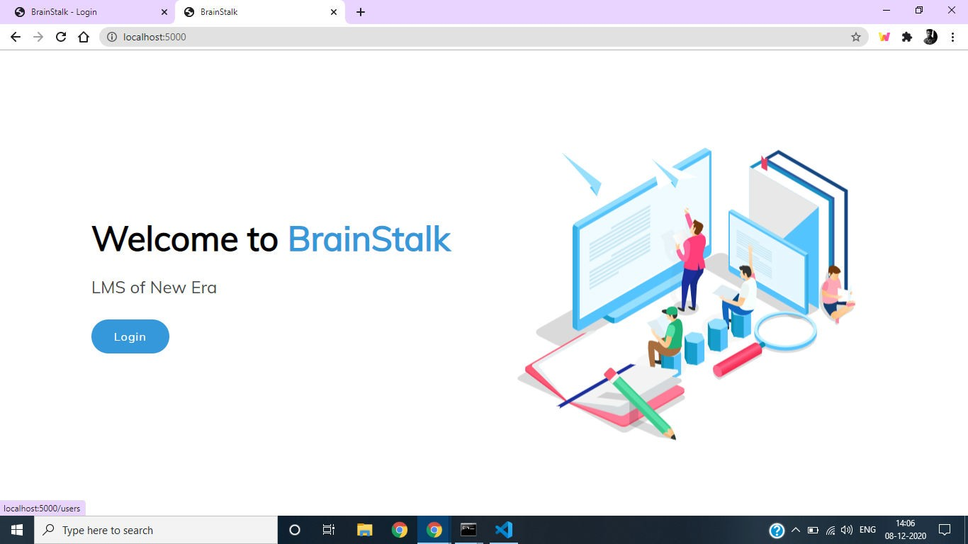
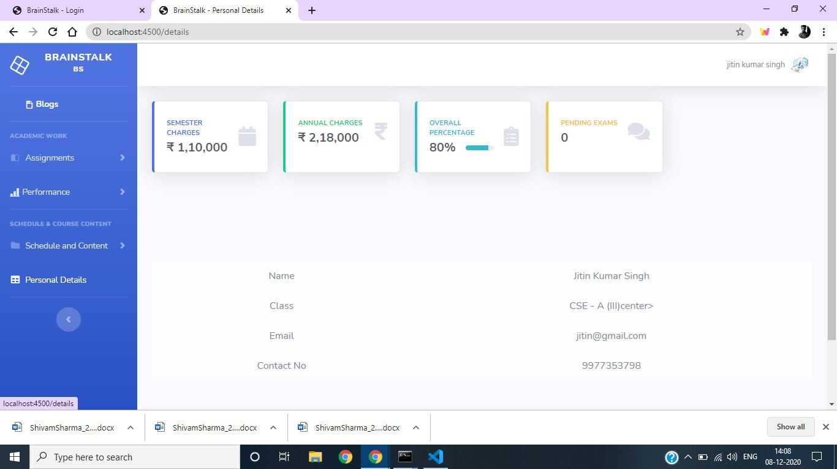

Slide 21
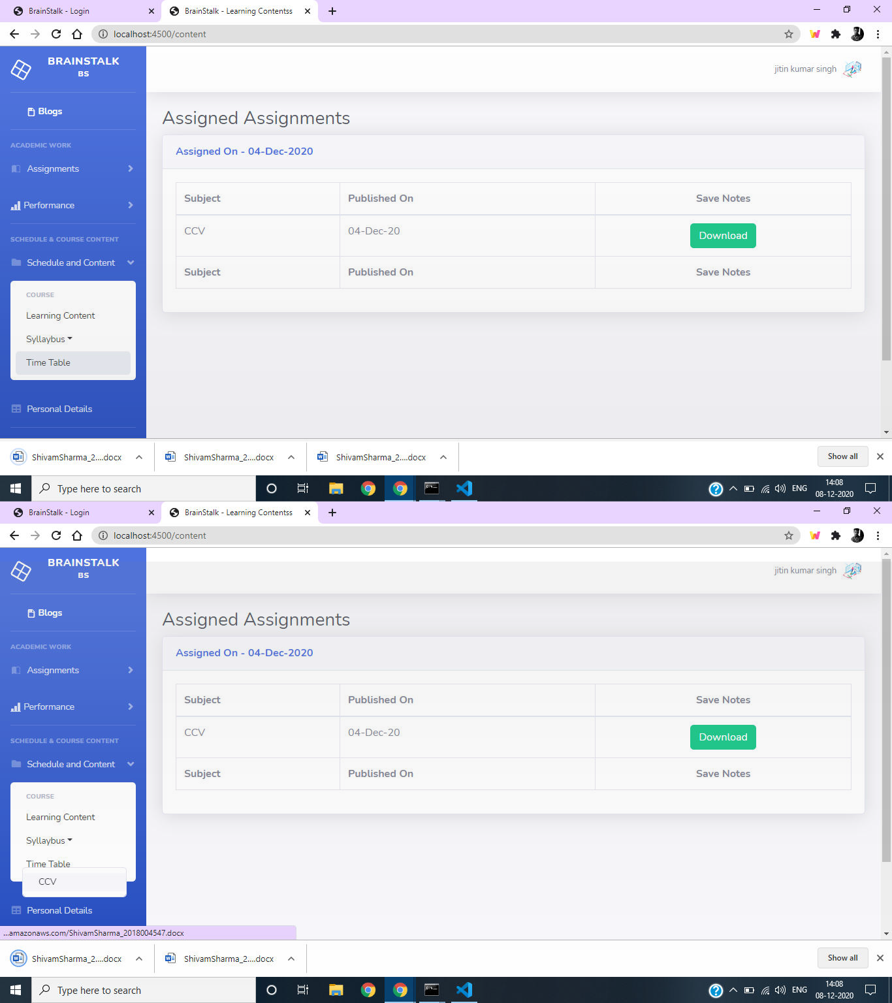

Slide 22
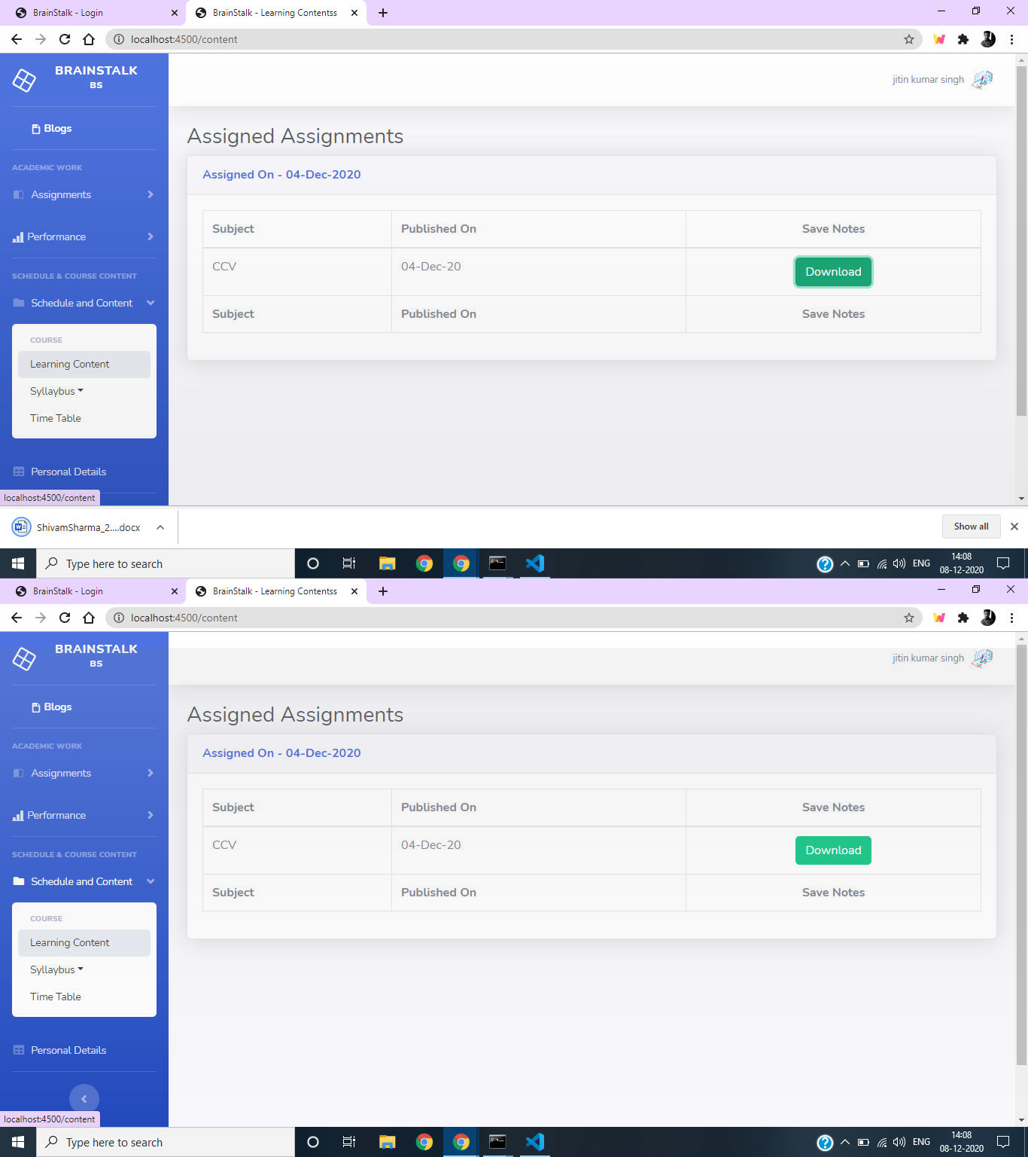

Slide 23
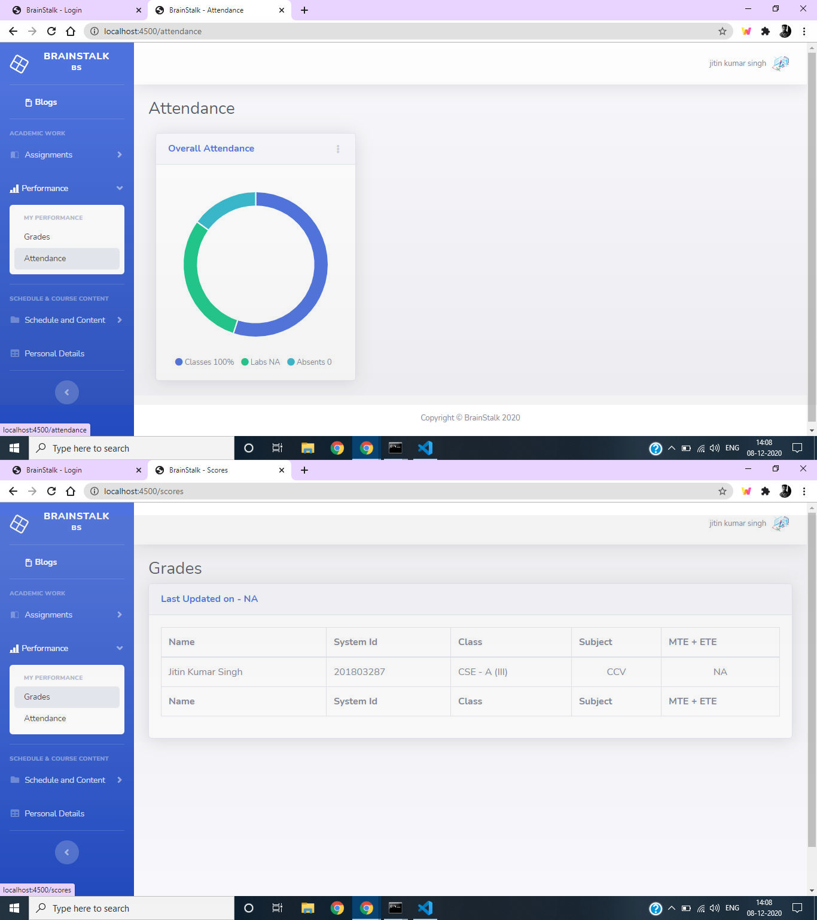

Slide 24
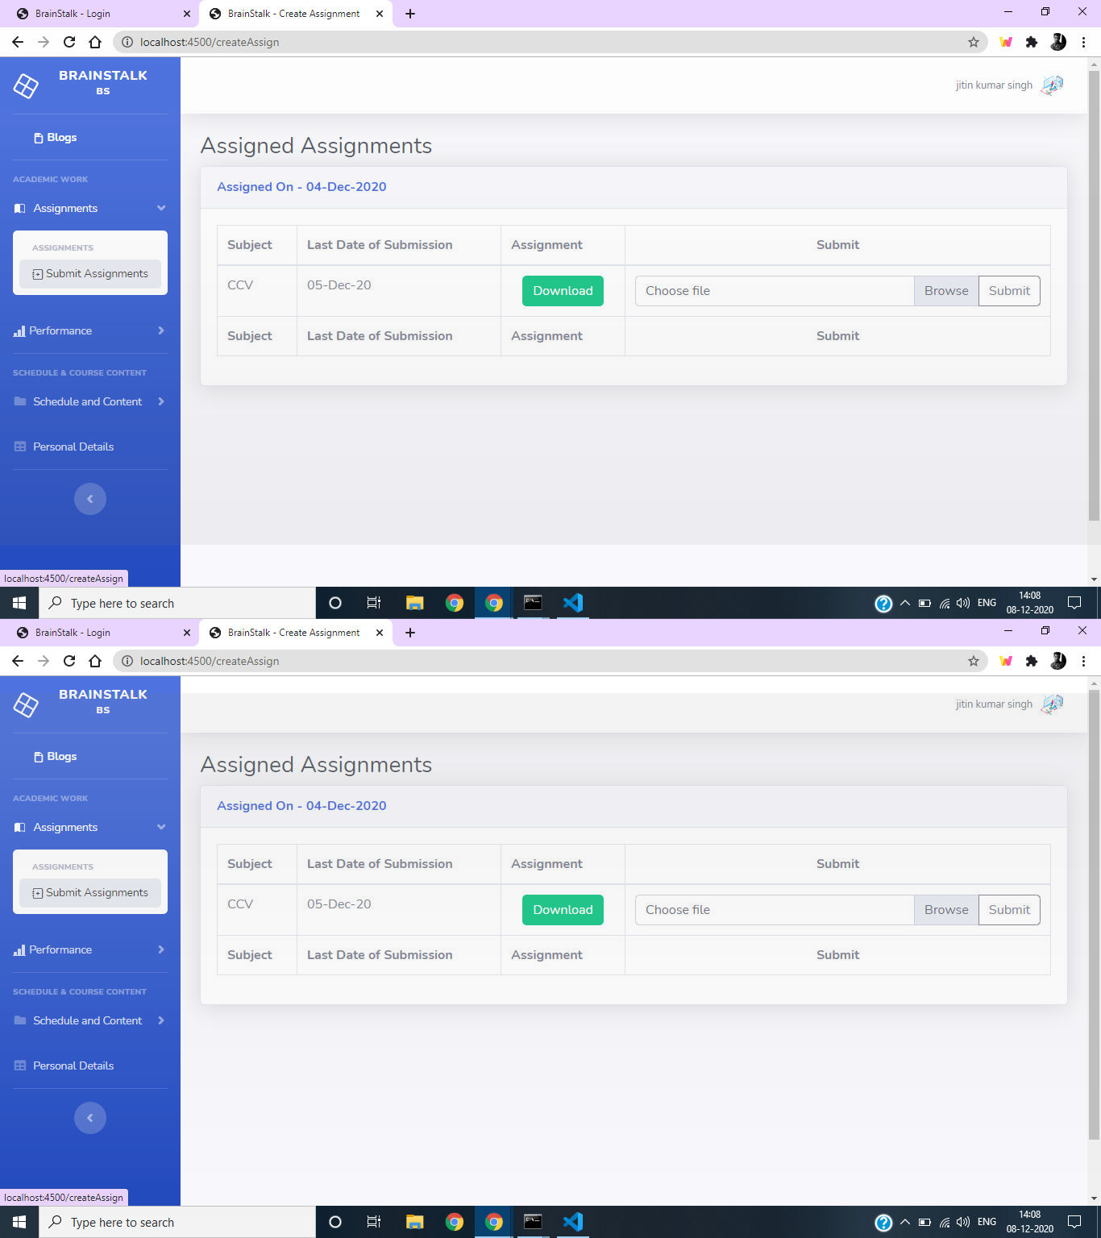

Slide 25
